Slide 1


Slide 2
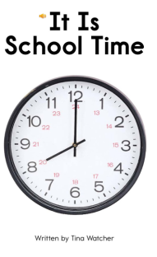

Slide 3
Click to see what time is it for.
breakfast
bus
lunch
school
math
reading
recess
music
science
home

Slide 4
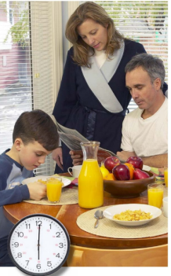
It is time for breakfast.
return

Slide 5
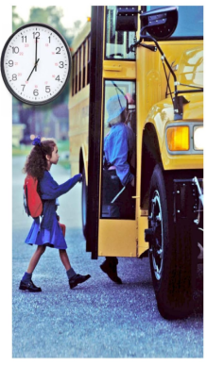
It is time for bus.
return

Slide 6
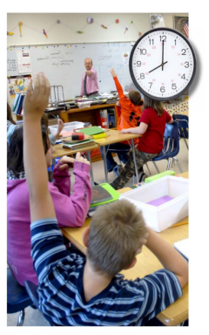
It is school time.
return

Slide 7
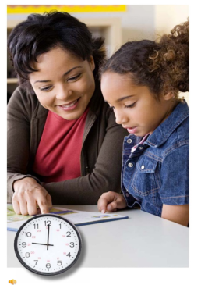
It is time for reading.
return

Slide 8
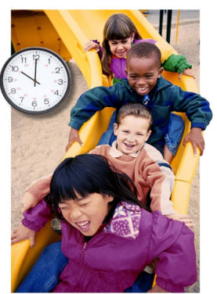
It is recess time .
return

Slide 9
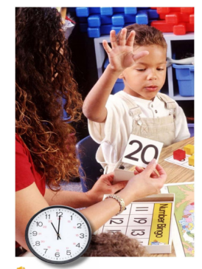
It is time for lunch.
return

Slide 10
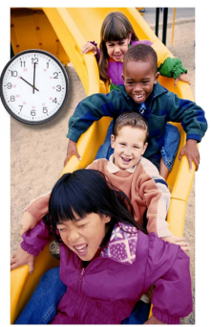
It is time for math.
return

Slide 11
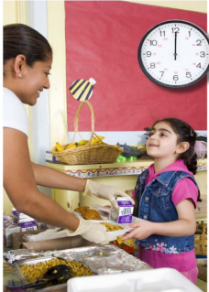
It is time for music time.
return

Slide 12
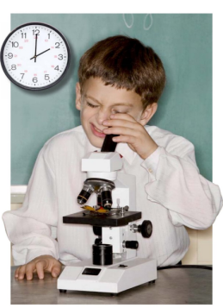
It is time for music sciencce.
return

Slide 13
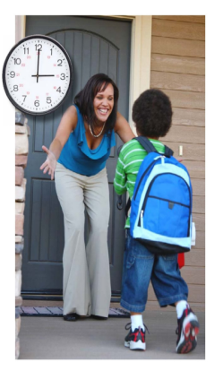
It is time for music home!
return

